Slide 1
SWIPE MY RIDE
Team:
Adrian Fehr
Freddie Vincent
Shannon Imbo
Justin Shand
Daniel Mafile’o

Slide 2
Description & features
Login screen
Main interface
Garage Database
Messenger System
Car Upload

Slide 3
Sprint 0

Slide 4
Sprint 1

Slide 5
Sprint 2

Slide 6
Scrum process
Activities
Artefacts
Roles

Slide 7
Details & roles

Slide 8
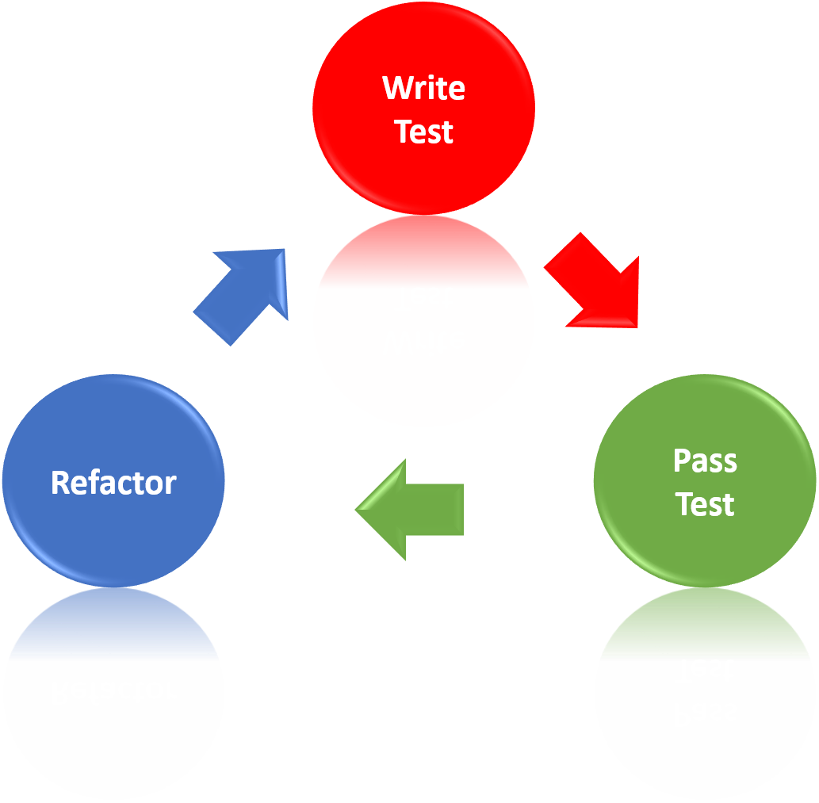
Testing + Quality assurance
Ways we assured quality:
Kept User Stories small and focused
Acceptance Testing
Used as a kind of goal to keep development on track
Maintained good communication between team members :
So we'd know how our User Stories would fit together
And maintain a shared pool of knowledge between us
Unit Testing and Test Driven Development

Slide 9


Testing + Quality assurance
Used Test Driven Development where possible
Difficulties:
Flutter is primarily User Interface based
The functions are difficult to test
Solution:
Make a function to be tested a class of its own
Simply test this class instead of the function

Slide 10
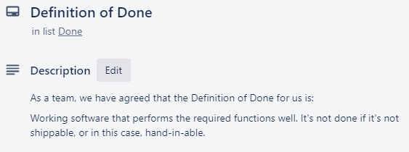
Testing + Quality assurance
Definition of Done:
The final say
If our checklist passed, we could say the program was done to a high standard

Slide 11
Development Issues

Slide 12
Future features

Slide 13
Team issues

Slide 14
Lessons learnt

Slide 15
User stories

Slide 16
demonstration
https://trello.com/b/ht4Wqblm/2019s254swipemyride

